Slide 1


Graphics and Computational Programming
Maria Tozo
Notes:
Voice should be like if you showed it to an employer

Slide 2
Project Information
For this project I choose to do a parallel ray tracer. With an end result that is able to render some simple shapes with a choice of different material for each shape that would interact with multiple lights.
Throughout this video I will go over and discuss my research into ray tracing and parallelisation and how it helped me in design and implement my ray tracer

Slide 3

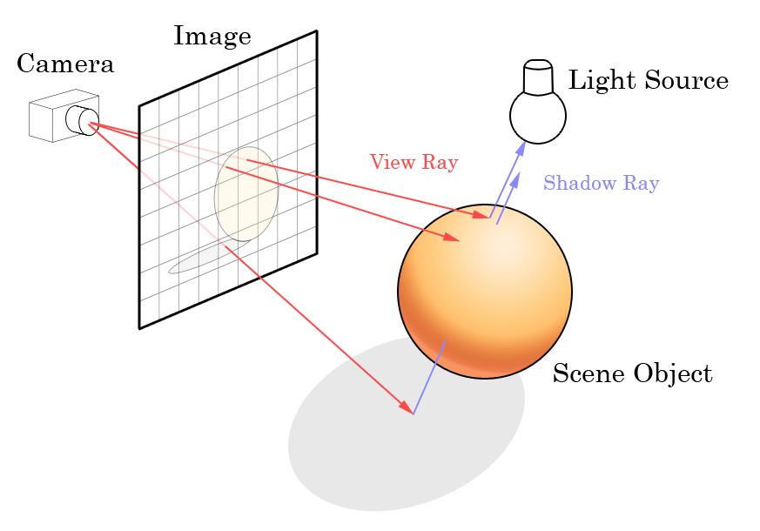
What is Ray Tracing?
Ray Tracing is the process of rendering a 3D images on a 2D display by tracing a path of light through pixels on an image plane.
Ray tracing is done by sending a ray that represents a pixel from your camera point into the scene that checks for a collision with any scene objects and return it’s color.
Though it’s capable of producing a much higher degree of realism over other rendering methods, it comes a much greater computational cost and can take a while to render an image.
This Photo by Unknown Author is licensed under CC BY-SA
Notes:
Diagram – definitely
Go deeper into things
Go into more complex things -> shadows, reflections -> overview of theory and how its done
Do analyse as well
This cost was fine for producing images in TV and film had been much to high for games to implement into real-time. But with technological advances, like the Nvidia GeForce RTX 2080, it is slowly becoming possible for real-time.

Slide 4
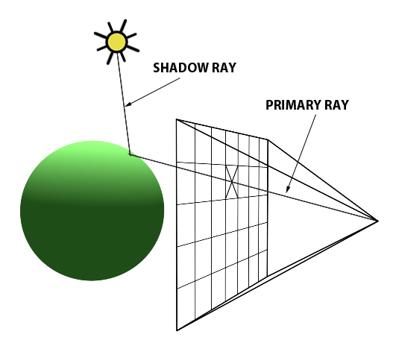
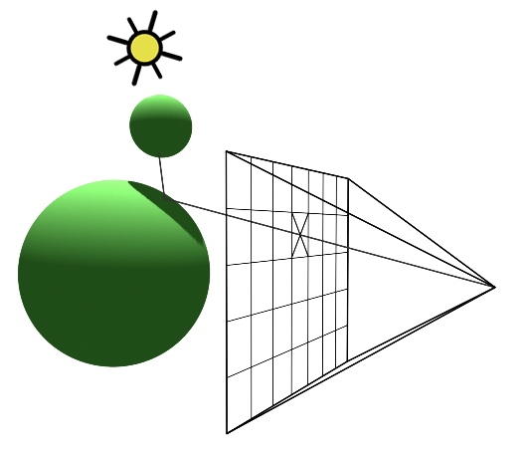
Shadows
Shadows easily done in raytracing and often only need a handful of lines to implement.
The basic method of checking for shadows is that after a ray has collided with an object send another ray from said point to your light source. If the ray collides with any of the objects in the scene then the point your checking is in shadow.

Slide 5
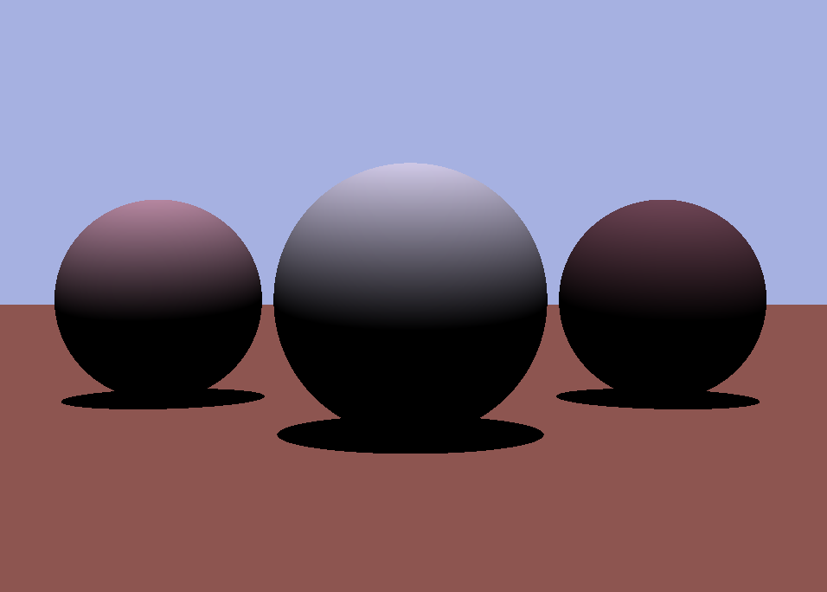
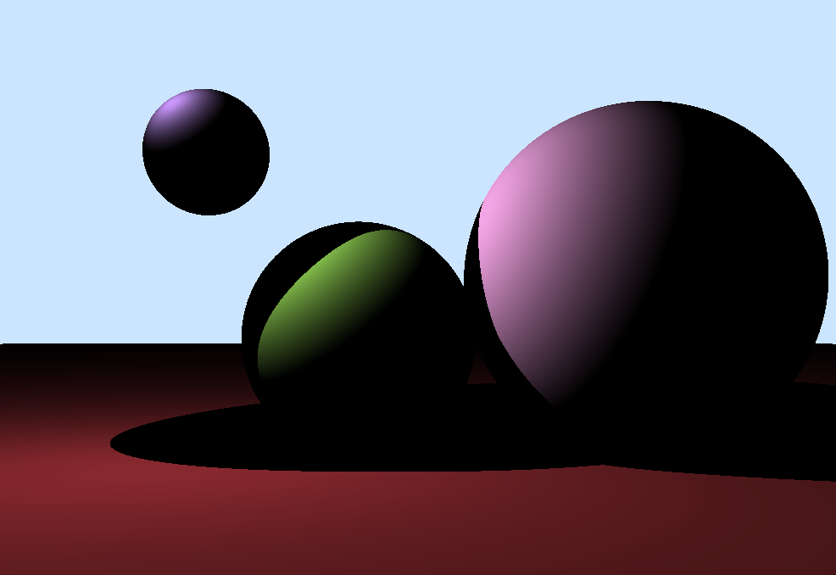
My Examples

Slide 6
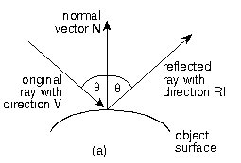
Reflections
Similar to shadows reflections are done by simply by sending another ray from your hit point into the scene. The main difference being that the direction of this new ray is not to the light source but by using this equation
NewDirection = V + (2 * N * – Dot_Product(N, V))
And like with shadows we check if it intersecs with anything in the scene an if it does we return said colitions color

Slide 7
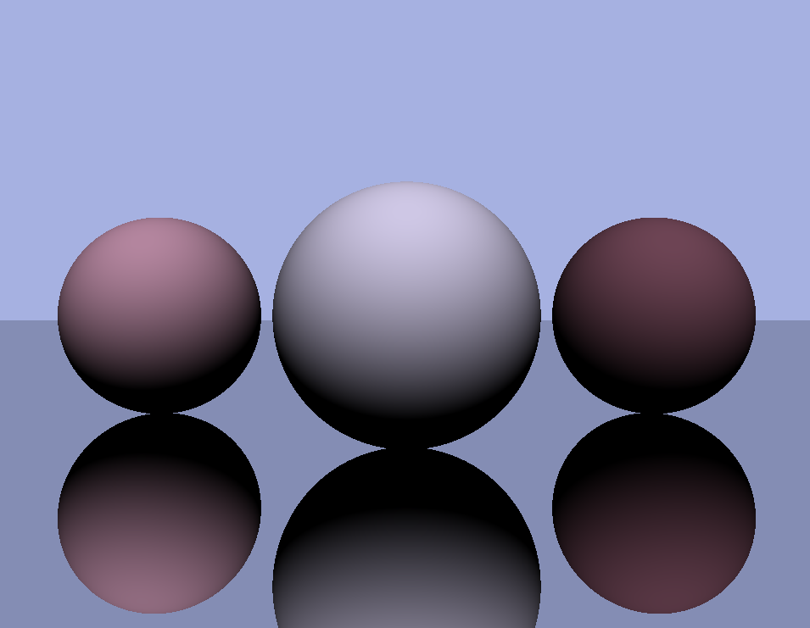
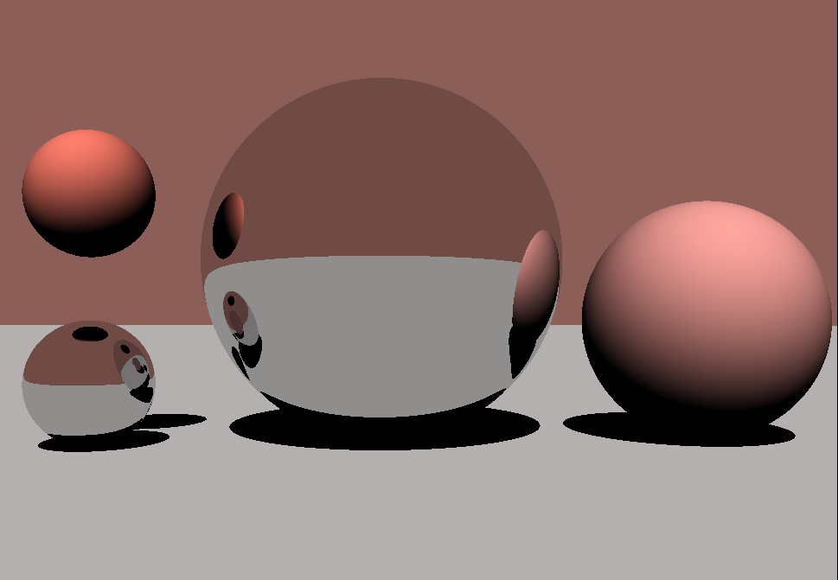
My Examples

Slide 8
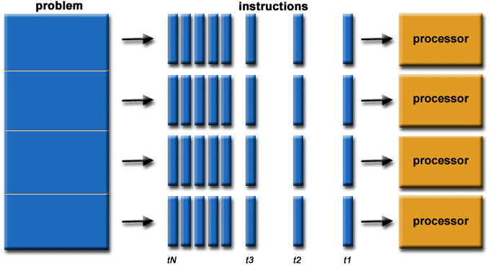
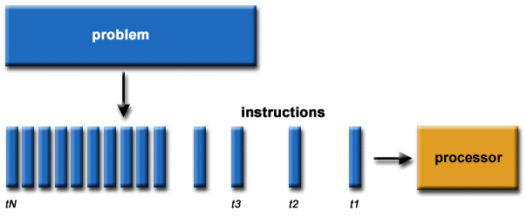
What is parallel programming?
Parallel programming is a type of computation in which many processes or the execution of processes are carried out simultaneously.
There are several ways to make a program parallel but most mainly center around breaking a large task into smaller tasks and running them in parallel.
Though it can be tricky to understand and first and test it increase the efficiency and resources of a program and gain the ability to achieve results much quicker.

Slide 9
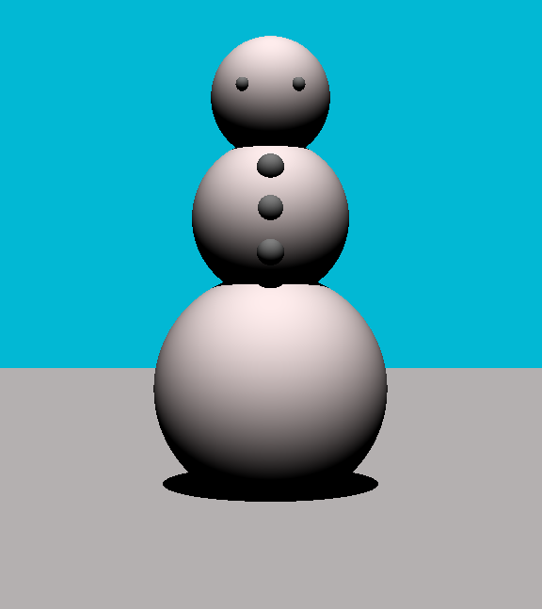
Ray Tracing & parallelisation
Ray tracing lends itself nicely to parallelisation as each pixel can be easily be rendered in parallel.
This can make significant cuts to the rendering time that ray tracing on the GPU is known for. The way I have decided to do this is by using multi-threading.
With a pool of threads that get given the task to render a part of the screen, then when all rays are done for it to display onto the screen as one image.
Notes:
Bullet points mostly
There are other parts that can also be can be parallelized but are less suited to a small scale such as this.

Slide 10
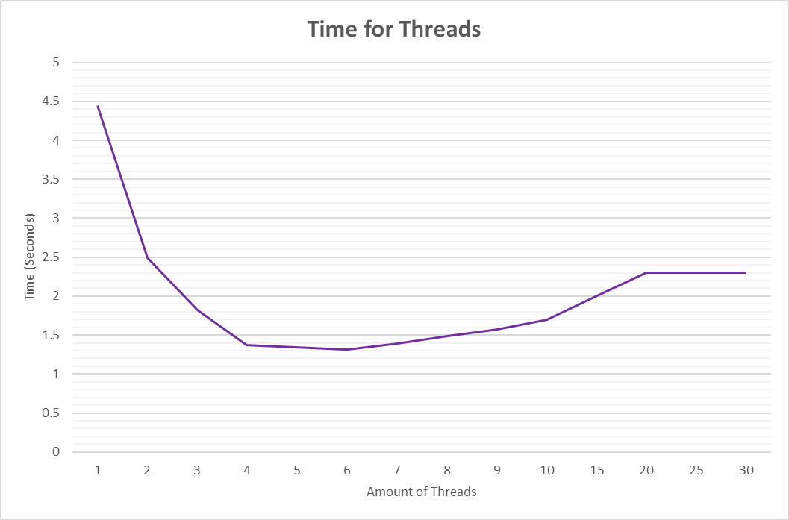
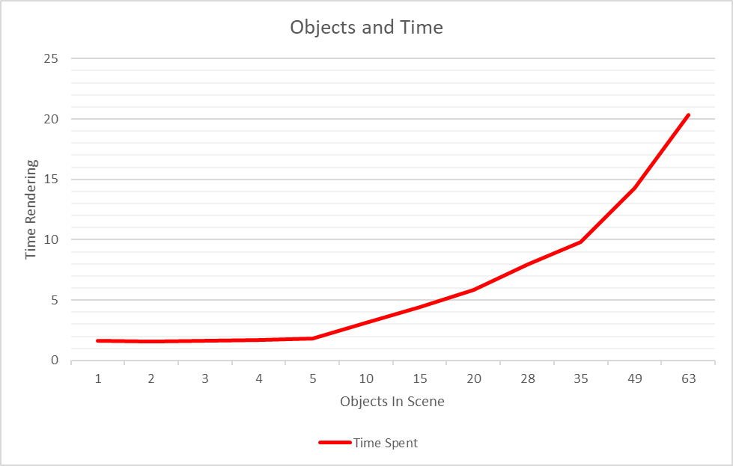
Experiments
Notes:
Graphs onto threads and objects and dept and stuff

Slide 11

Evaluation

